Slide 2
FoodTruck Business Database
INFO 6210
DATA MANAGEMENT AND DATABASE DESIGN
Project Team 8:
Vijayakumar Venkataraman
Rohith Reddy Narra
Venkat Mithun Kadiyala
Raghuram Arun Srinivas

Slide 3
Agenda
Introduction
Database Design
Implementation
Report Analysis

Slide 4
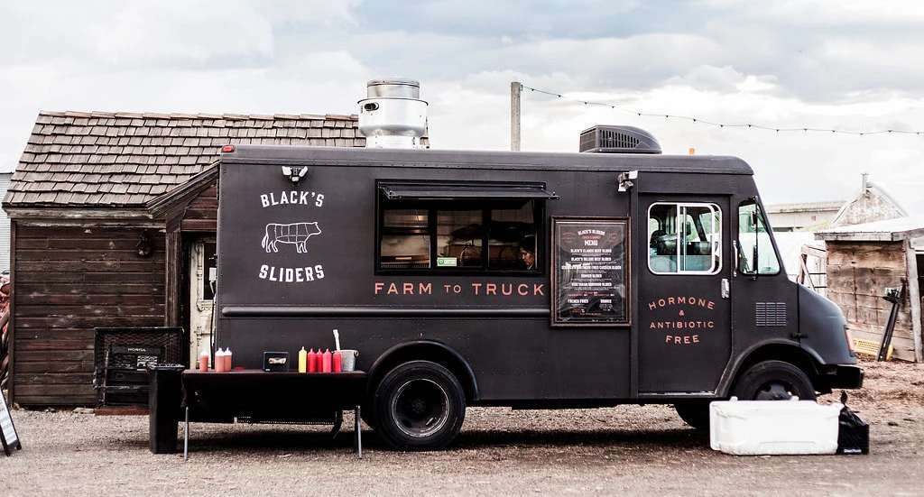
Introduction
The Foodtruck industry has unique requirement when manage the data it generate from its business.
There is no recognized system
in place to support the foodtruck
business.

Slide 5
Mission Objective
The purpose of the database is to maintain data of FoodTrucks across the city and leverage the orders data to improve profits.
The problems we have addressed in this project are as follows:
Maintain all relevant information on Foodtrucks such as Order, Customer, Staff, Supplies, Income , Expenditure and Revenue.
Analyze all location and cuisine related data from the orders of each Foodtruck.
Analyze Income, Expenditure and Revenue of all Foodtrucks, such that Foodtruck owners get clear understanding of their business output.

Slide 6
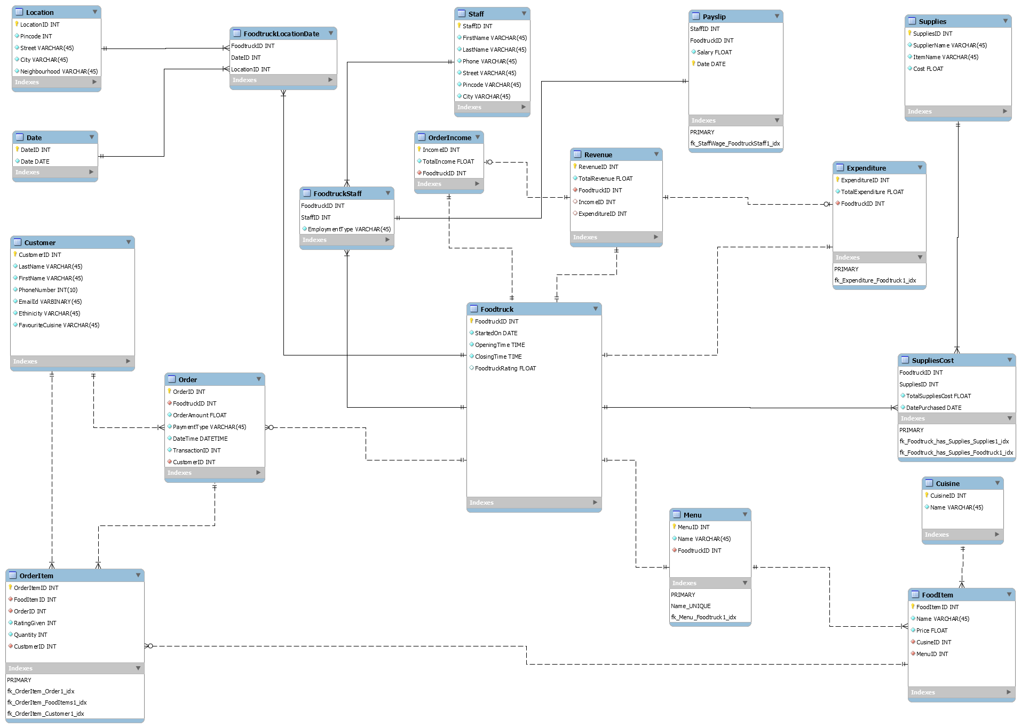

Slide 7
Database implementation
SQL DDL Statements
Check constraints (Payment type, Rating Given, Employment type, FoodItem Price, Quantity)
Encryption on Customer EmailID
Trigger Functions
Notes:
LinkedIn headshot event

Slide 8
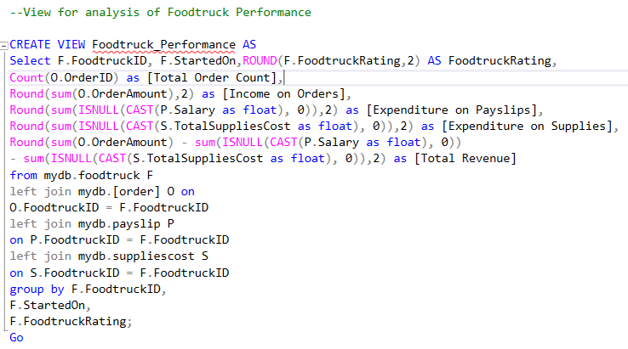
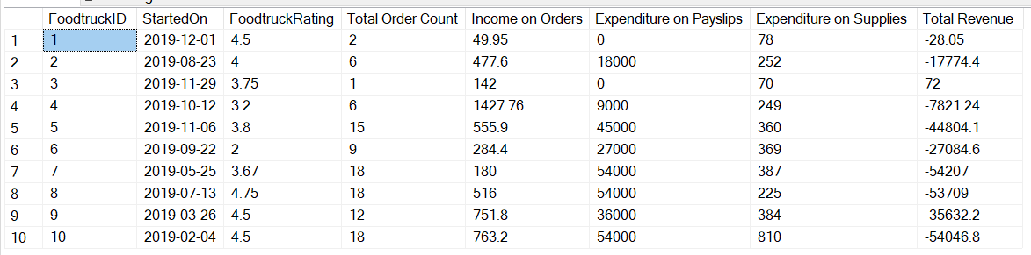
Foodtruck Performance

Slide 9
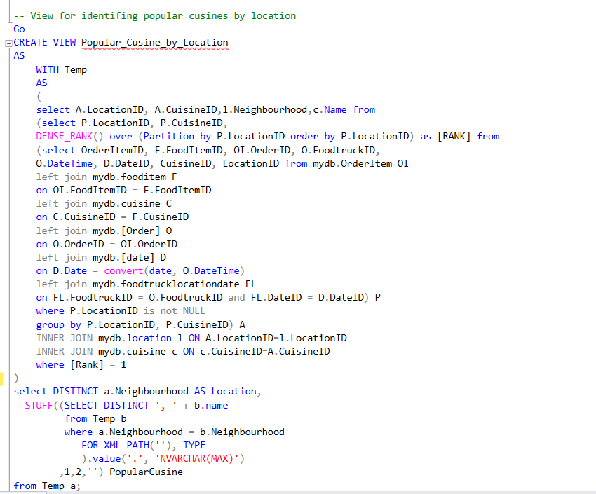
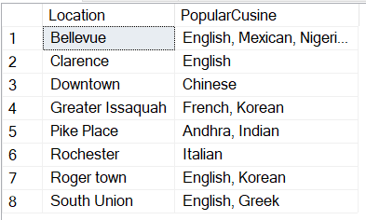
Popular Cuisine by Location

Slide 10
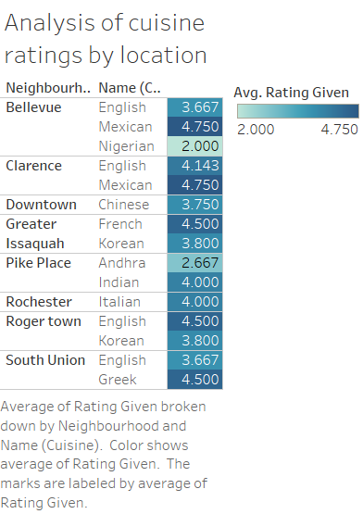

Slide 11
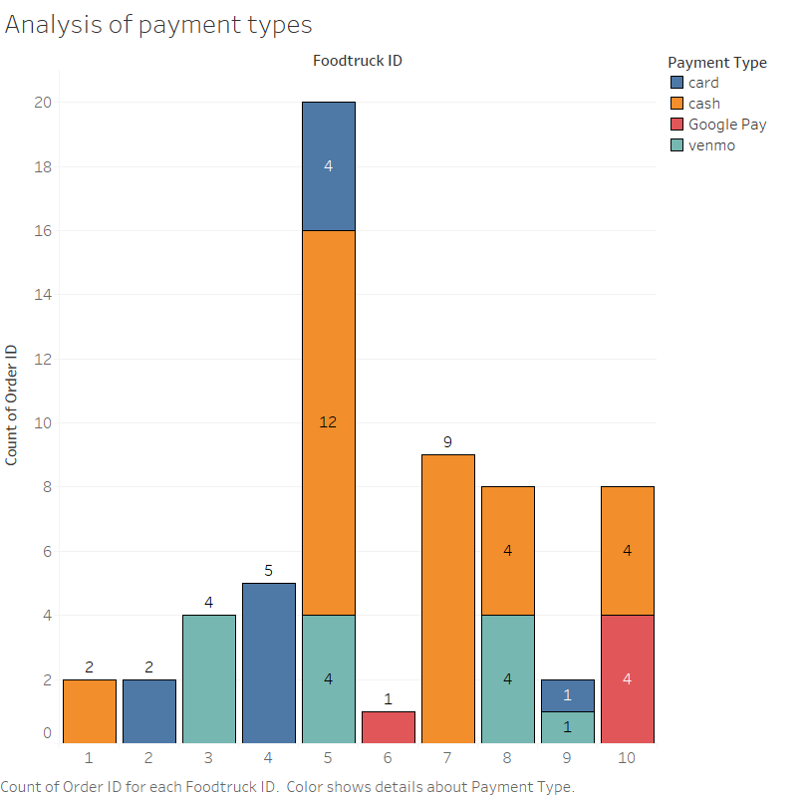

Slide 12

Any Questions?

